Slide 1
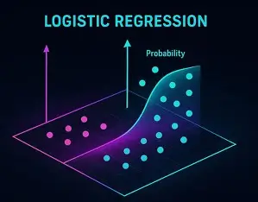
LOGISTIC REGRESSION
Dr Ashok Gopalakrishnan
Professor Emeritus
UN Fellow for Post Doctoral Research @ The German Academy of Sciences, Leipzig, Berlin

Slide 2
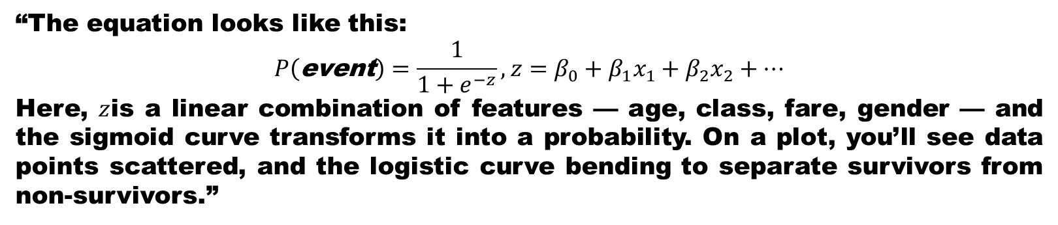
LOGISTIC REGRESSION
“Imagine you’re trying to predict whether a passenger on the Titanic survived or not. The outcome isn’t a number like fare or age — it’s a category: yes or no. This is where Logistic Regression comes in. Unlike linear regression, which predicts continuous values, logistic regression helps us classify outcomes into categories.”
“At its heart, logistic regression uses the sigmoid function — an S‑shaped curve that maps any input into a probability between 0 and 1. If the probability is above 0.5, we classify it as ‘yes’; if below 0.5, we classify it as ‘no’. This makes logistic regression perfect for problems like survival prediction, spam detection, or medical diagnosis.”
“The equation looks like this:
$$P\left(\text{event}\right)=\frac{1}{1+e^{−z}}, z=β_{0}+β_{1}x_{1}+β_{2}x_{2}+…$$
Here, $z$is a linear combination of features — age, class, fare, gender — and the sigmoid curve transforms it into a probability. On a plot, you’ll see data points scattered, and the logistic curve bending to separate survivors from non‑survivors.”

Slide 3
LOGISTIC REGRESSION
Logistic regression is increasingly used in space science to classify, predict, and interpret complex mission data — from rocket launch success to stellar classification and solar event detection. It helps scientists make binary decisions (e.g., success/failure, flare/no flare) based on multiple mission or observational parameters.

Slide 4
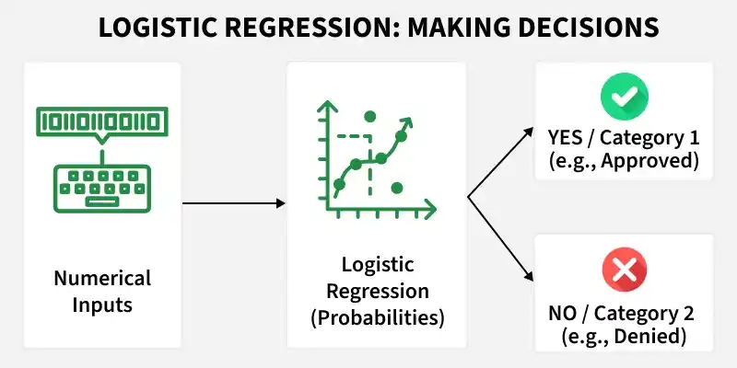
LOGISTIC REGRESSION

Slide 5
Applications of Logistic Regression in Space Science
Domain | Example Use | Key Insights
Rocket Launch Analysis | Predicting whether a rocket launch will succeed based on features like launch year, rocket status, payload mass, and booster reuse. | Logistic regression models trained on datasets such as the Kaggle Space Missions or SpaceX Falcon 9 data achieved strong predictive accuracy for binary outcomes (success/failure).
Reusable Rocket Landings (SpaceX Falcon 9) | Classifying successful vs. unsuccessful booster landings using parameters like payload mass, flight count, and reuse status. | The model’s coefficients reveal which factors most influence landing success — e.g., reused boosters and lower payload mass increase success probability.
Stellar Classification | Categorizing stars based on color–color diagrams and spectral data. | Logistic regression helps separate stellar types (e.g., main‑sequence vs. giants) using photometric features, providing interpretable coefficients for astrophysical relationships.
Solar Event Detection (Aditya‑L1, NASA missions) | Classifying coronal mass ejections (CMEs) or flare events vs. quiet periods using solar wind and X‑ray data. | Logistic regression converts continuous sensor readings into probabilities of event occurrence, aiding real‑time space‑weather prediction. (Inference based on current solar data analysis practices.)

Slide 6
Why Logistic Regression Works Well in Space Research
Binary outcomes: Many space problems are yes/no — launch success, flare occurrence, signal detection.
Interpretability: Coefficients show how each variable (e.g., payload mass, solar flux) affects the log‑odds of success or event detection.
Efficiency: Works well with limited datasets typical of mission telemetry or observational campaigns.
Robustness: Less prone to overfitting than complex models, making it ideal for early‑stage mission analytics.
Example Insight
In a rocket‑launch success prediction study, logistic regression identified launch year as the most influential feature, while rocket status code had weaker correlation. Hyperparameter tuning (C = 0.01, penalty = ‘l1’, solver = ‘liblinear’) optimized accuracy.
Similarly, in stellar classification, logistic regression achieved reliable separation of star types using photometric colors, demonstrating its value for interpretable astrophysical modeling.

Slide 7
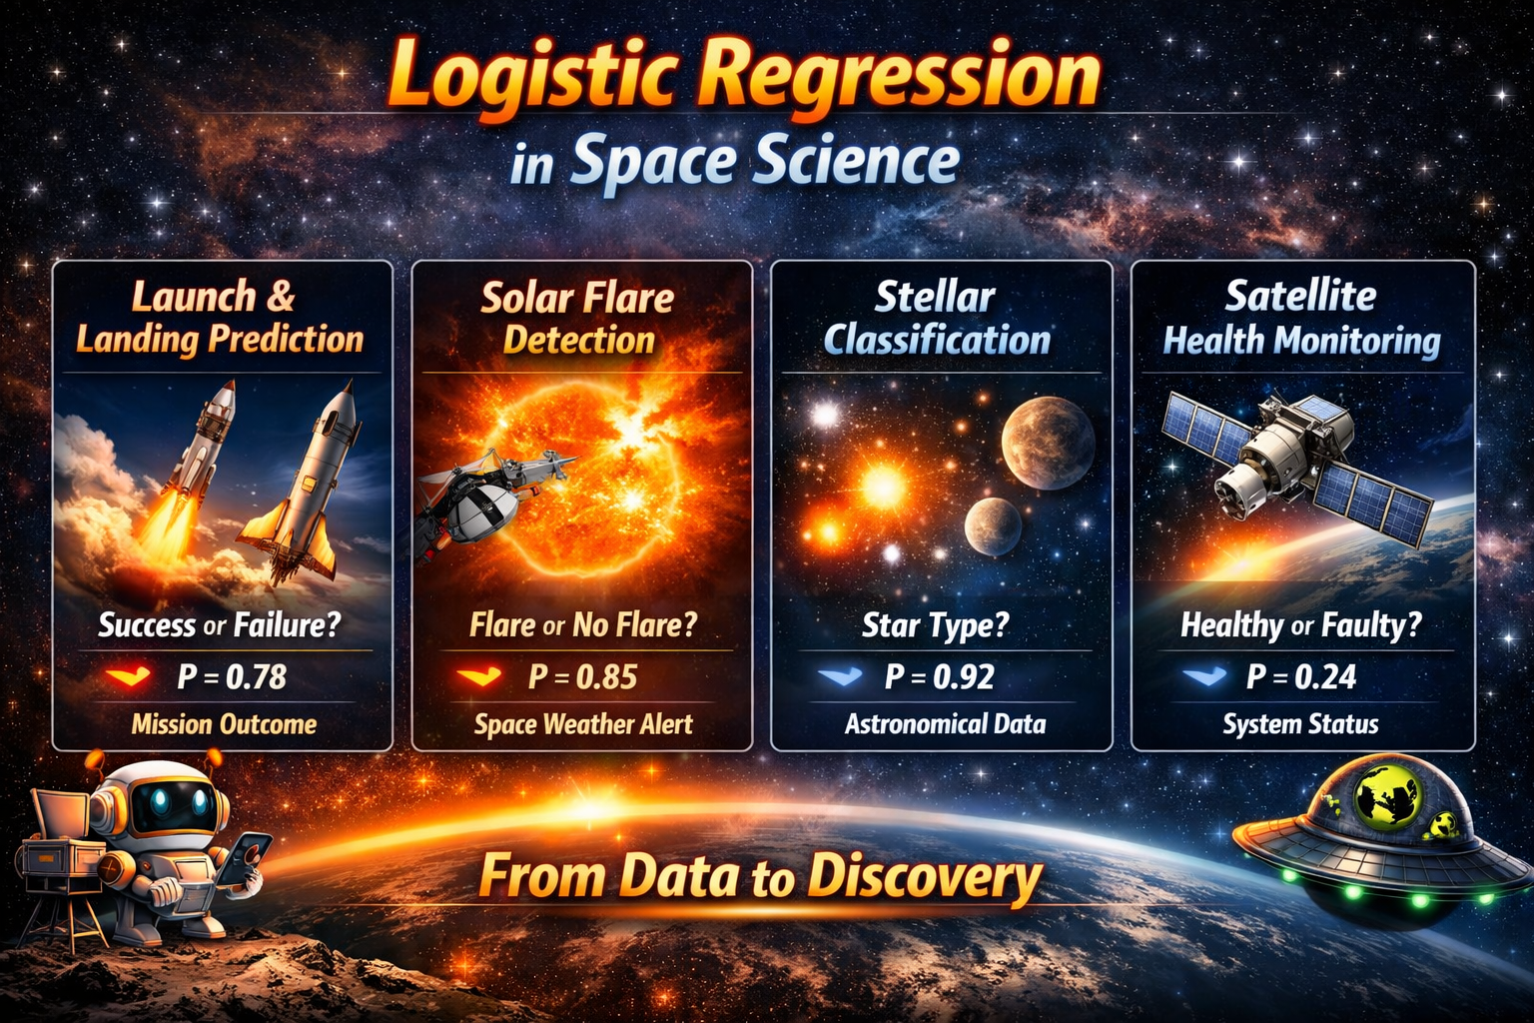

Slide 8
Rocket Launch & Booster Landing
Logistic regression is used to predict launch success or failure based on features like payload mass, launch site, booster reuse, and weather conditions.
SpaceX Falcon 9 studies show logistic regression can classify successful vs. unsuccessful booster landings, with coefficients revealing which factors most strongly influence outcomes.
Solar Physics & Space Weather
Missions like Aditya‑L1 and NASA’s SOHO use logistic regression to classify solar flare or CME occurrence vs. quiet periods.
Input features: solar wind speed, X‑ray flux, magnetic field strength.
Output: probability of an event, aiding satellite protection and astronaut safety.
Stellar & Exoplanet Classification
Astronomers apply logistic regression to categorize stars (main‑sequence vs. giants) using photometric color indices.
In exoplanet detection, logistic regression helps classify light‑curve signals as planet transit vs. noise.
Its interpretability makes it ideal for small telescope datasets.
Satellite Health Monitoring
Telemetry data (temperature, voltage, vibration) can be modeled with logistic regression to predict healthy vs. faulty states.
Supports predictive maintenance and autonomous onboard decisions.
In short, logistic regression is a bridge between data science and astrophysics — helping scientists classify cosmic phenomena, predict mission outcomes, and safeguard space assets.

Slide 9
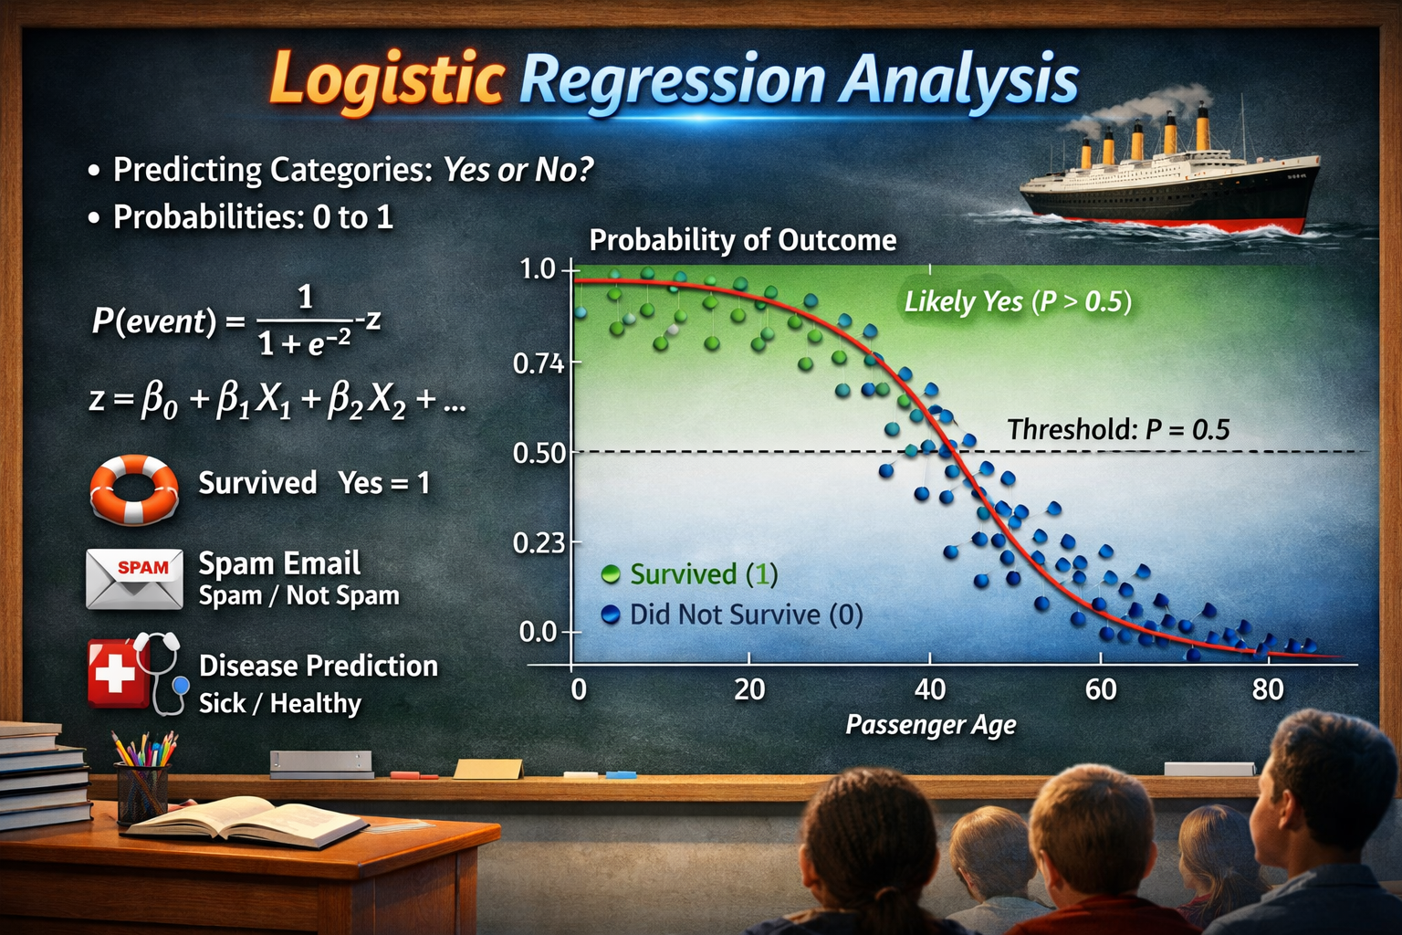
LOGISTIC REGRESSION
“So, logistic regression is more than just math — it’s a way of turning uncertainty into clarity. It allows us to say not just what might happen, but how likely it is to happen. Whether we’re studying human behavior or solar events, logistic regression is a powerful tool for classification and decision‑making.”

Slide 10
LOGISTIC REGRESSION
Logistic Regression is a supervised machine learning algorithm used for classification problems. Unlike linear regression, which predicts continuous values it predicts the probability that an input belongs to a specific class.
It is used for binary classification where the output can be one of two possible categories such as Yes/No, True/False or 0/1.
It uses sigmoid function to convert inputs into a probability value between 0 and 1.
Binomial Logistic Regression: Used when the dependent variable has only two possible categories, such as Yes/No, Pass/Fail, or 0/1. It is the most common type and is used for binary classification tasks.
Multinomial Logistic Regression: Used when the dependent variable has three or more unordered categories. For example, classifying animals as cat, dog, or sheep. It extends logistic regression to handle multiple classes.
Ordinal Logistic Regression: Used when the dependent variable has three or more categories with a natural order, such as Low, Medium, and High. It considers the ranking of categories during prediction.

Slide 11
LOGISTIC REGRESSION
Understanding Sigmoid Function
1. The sigmoid function is a key component of Logistic Regression that converts the model's raw output into a probability value between 0 and 1.
2. This function takes any real number and maps it into the range 0 to 1 forming an "S" shaped curve called the sigmoid curve or logistic curve. Because probabilities must lie between 0 and 1, the sigmoid function is perfect for this purpose.
3. In logistic regression, we use a threshold value usually 0.5 to decide the class label.
If the sigmoid output is same or above the threshold, the input is classified as Class 1.
If it is below the threshold, the input is classified as Class 0.

Slide 12
LOGISTIC REGRESSION
Assumptions
Independent Observations: Each data point should be independent of the others, meaning there should be no dependence between observations.
Binary Dependent Variable: The target variable is typically binary and can take only two values, such as 0/1 or Yes/No. For multiclass problems, extensions such as Softmax-based logistic regression are used.
Linearity of Log-Odds: The independent variables should have a linear relationship with the log-odds of the dependent variable.
No Extreme Outliers: Extreme outliers can distort coefficient estimates and negatively affect model performance.
Large Sample Size: A sufficiently large dataset helps produce more reliable and stable predictions.

Slide 13
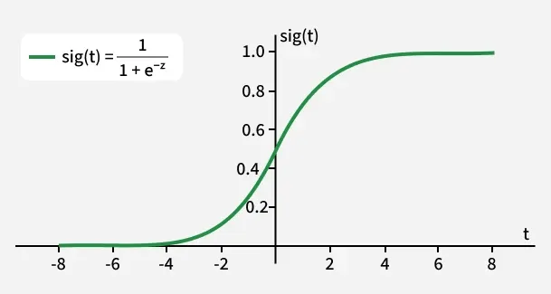
LOGISTIC REGRESSION
Logistic regression computes a linear combination of input features (z = w·X + b) and passes it through a sigmoid function to produce a probability between 0 and 1. This probability is then used to assign the input to a class.

Slide 14
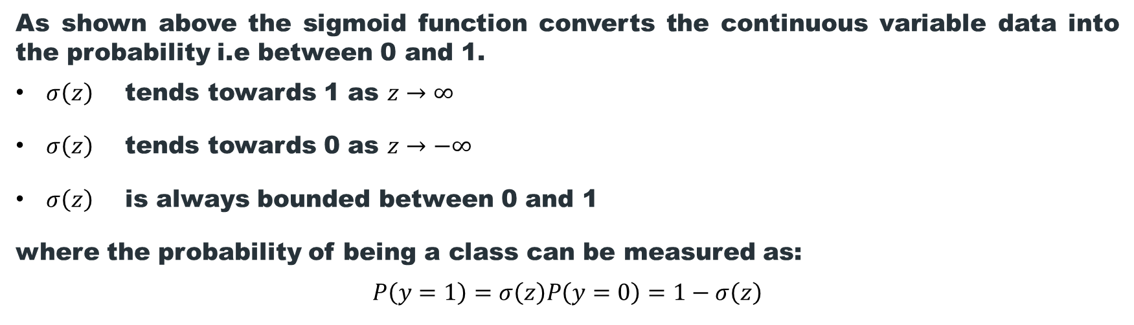
LOGISTIC REGRESSION
As shown above the sigmoid function converts the continuous variable data into the probability i.e between 0 and 1.
$σ\left(z\right)$ tends towards 1 as $z→∞$
$σ\left(z\right)$ tends towards 0 as $z→−∞$
$σ\left(z\right)$ is always bounded between 0 and 1
where the probability of being a class can be measured as:
$$P\left(y=1\right)=σ\left(z\right)P\left(y=0\right)=1−σ\left(z\right)$$
In binomial logistic regression, the target variable can only have two possible values such as "0" or "1", "pass" or "fail". The sigmoid function is used for prediction.
I will be using Scikit-learn library for this and show how to use the breast cancer dataset to implement a Logistic Regression model for classification.

Slide 15
LOGISTIC REGRESSION
from sklearn.datasets import load_breast_cancer
from sklearn.linear_model import LogisticRegression
from sklearn.model_selection import train_test_split
from sklearn.metrics import accuracy_score
X, y = load_breast_cancer(return_X_y=True)
X_train, X_test, y_train, y_test = train_test_split(X, y, test_size=0.20, random_state=23)
clf = LogisticRegression(max_iter=10000, random_state=0)
clf.fit(X_train, y_train)
acc = accuracy_score(y_test, clf.predict(X_test)) * 100
print(f"Logistic Regression model accuracy: {acc:.2f}%")
Output:
Logistic Regression model accuracy (in %): 96.49%
This code uses logistic regression to classify whether a sample from the breast cancer dataset is malignant or benign.

Slide 16
LOGISTIC REGRESSION
Differences Between Linear and Logistic Regression
Aspect | Linear Regression | Logistic Regression
Definition | Linear regression is used to predict the continuous dependent variable using a given set of independent variables. | Logistic regression is used to predict the categorical dependent variable using a given set of independent variables.
Problem Type | It is used for solving regression problem. | It is used for solving classification problems.
Output Type | In this we predict the value of continuous variables. | In this we predict values of categorical variables.
Curve/Model Fitting | In this we find best fit line. | In this we find S-Curve.
Estimation Method | Least square estimation method is used for estimation of accuracy. | Maximum likelihood estimation method is used for estimation of accuracy.
Output Example | The output must be continuous value such as price, age etc. | Output must be categorical value such as 0 or 1, Yes or No, etc.

Slide 17
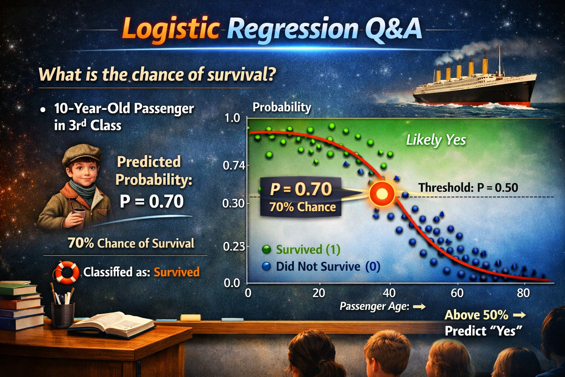
LOGISTIC REGRESSION

Slide 18
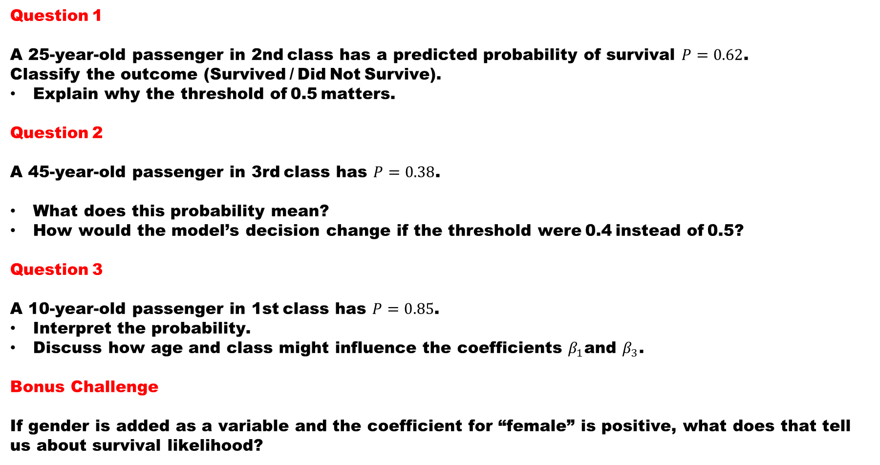
Logistic Regression Mini Quiz — Titanic Dataset
Question 1
A 25‑year‑old passenger in 2nd class has a predicted probability of survival $P=0.62$.
Classify the outcome (Survived / Did Not Survive).
Explain why the threshold of 0.5 matters.
Question 2
A 45‑year‑old passenger in 3rd class has $P=0.38$.
What does this probability mean?
How would the model’s decision change if the threshold were 0.4 instead of 0.5?
Question 3
A 10‑year‑old passenger in 1st class has $P=0.85$.
Interpret the probability.
Discuss how age and class might influence the coefficients $β_{1}$and $β_{3}$.
Bonus Challenge
If gender is added as a variable and the coefficient for “female” is positive, what does that tell us about survival likelihood?

Slide 19
We will build an example of Regression Analysis to classify that predicts whether a tumor is malignant or benign, based on medical measurements using Python.
Step 1: Import Required Libraries
numpy: Handles numerical computations and arrays
pandas: Used for data handling and tabular structures
matplotlib.pyplot: Helps visualize data and results
Scikit Learn: Used for model building
import numpy as np
import pandas as pd
import matplotlib.pyplot as plt
from sklearn.datasets import load_breast_cancer
from sklearn.model_selection import train_test_split
from sklearn.preprocessing import StandardScaler
from sklearn.linear_model import LogisticRegression
from sklearn.metrics import accuracy_score, confusion_matrix,precision_score, recall_score,f1_score,roc_curve, roc_auc_score

Slide 20
Step 2: Load the Dataset
This step loads the Breast Cancer dataset from scikit learn. The dataset is provided as a structured object that bundles everything needed for a classification task. It contains:
Feature matrix: Numerical measurements used as input to the model
Target labels: The class to predict
Feature names: Descriptions of each input feature
Metadata: Additional information about the dataset
This structure makes the dataset easy to explore, preprocess and use directly for model training.
data = load_breast_cancer()

Slide 21
Step 3: Convert Data to a Pandas DataFrame
The raw dataset is converted into pandas structures for easier handling and analysis. Using a DataFrame improves readability, supports exploratory data analysis and aligns with real world data workflows commonly used in production.
X represents the input features
y represents the target variable
X = pd.DataFrame(data.data, columns=data.feature_names)
y = pd.Series(data.target)
Step 4: Train and Test Split
X_train, X_test, y_train, y_test = train_test_split(
X, y, test_size=0.25, random_state=29
)

Slide 22
Step 5: Feature Scaling
This step standardizes feature values so they are on a similar scale. Logistic Regression uses gradient based optimization which is sensitive to feature magnitudes, so scaling helps the model train correctly. The scaler is fit only on training data and then applied to test data to avoid data leakage.
scaler = StandardScaler()
X_train = scaler.fit_transform(X_train)
X_test = scaler.transform(X_test)
Step 6: Train the Logistic Regression Model
This step trains the Logistic Regression model on the scaled training data. Here:
The model learns feature weights that separate the classes,
Applies the sigmoid function to compute probabilities.
Assigns a class based on those probabilities.
model = LogisticRegression(max_iter=1000)
model.fit(X_train, y_train)

Slide 23
Step 7: Make Predictions
At this stage, the trained model is used to make predictions on unseen test data. It computes probabilities for each class and applies a threshold (default = 0.5) to convert them into class labels.
1: Predicted as benign
0: Predicted as malignant
y_pred = model.predict(X_test)
y_pred
Step 8: Model Evaluation
At this stage, predictions are available. We now evaluate how well the model performs using multiple metrics, since each metric highlights a different aspect of performance.
“Logistic regression doesn’t just predict outcomes — it quantifies confidence. Every probability tells a story about how features interact to shape decisions.”

Slide 24
Today, we explored how logistic regression transforms uncertainty into clarity. Unlike linear regression, which predicts continuous values, logistic regression helps us classify outcomes — survival or not, spam or not, healthy or sick. At its core lies the sigmoid curve, mapping inputs into probabilities between 0 and 1, and giving us a decision boundary at 0.5. This simple yet powerful idea allows us to turn raw data into meaningful predictions.
We saw how features like age, class, and fare in the Titanic dataset influence survival probabilities, and how the logistic curve separates “likely yes” from “likely no.” Beyond the Titanic, logistic regression is widely used in medicine, finance, and even space science — wherever binary decisions matter. By mastering this tool, you gain not just a mathematical technique, but a way of thinking about data: every probability tells a story, and every story helps us make better decisions.
As you reflect on today’s session, remember that logistic regression is more than equations — it’s a lens to interpret the world. It empowers us to classify, to predict, and to innovate. Carry this insight forward, and you’ll see patterns everywhere, waiting to be decoded.

Slide 25
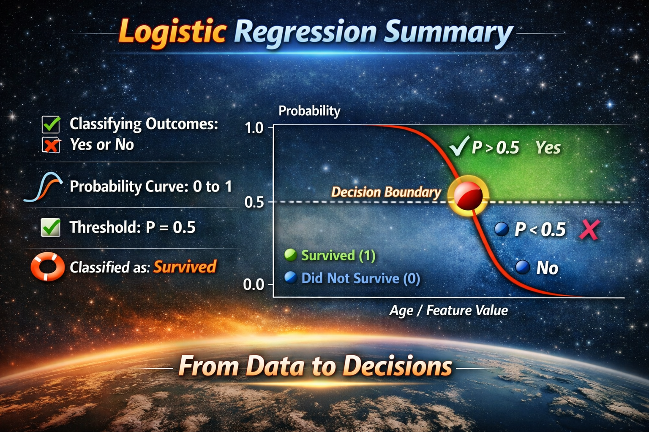
“Remember — regression isn’t just about equations. It’s about clarity, discovery, and innovation. Carry this insight forward, and you’ll see probabilities not as abstract numbers, but as stories about how the world works.”
“Beyond the math, logistic regression is a way of thinking about data. It shows us that every dataset carries patterns, and those patterns can be decoded into meaningful insights. Whether in space science, finance, or everyday decisions, logistic regression empowers us to move from data to decisions with confidence.”
“So, take this forward: from data to decisions. Let regression remind you that mathematics is not only about computation — it’s about comprehension, creativity, and the courage to explore patterns that shape our world.”

Slide 26


